Slide 1

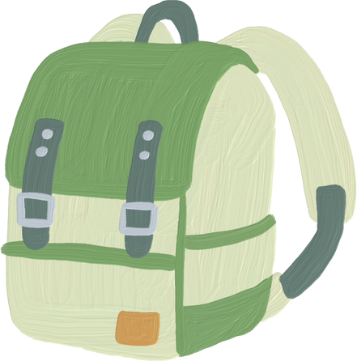
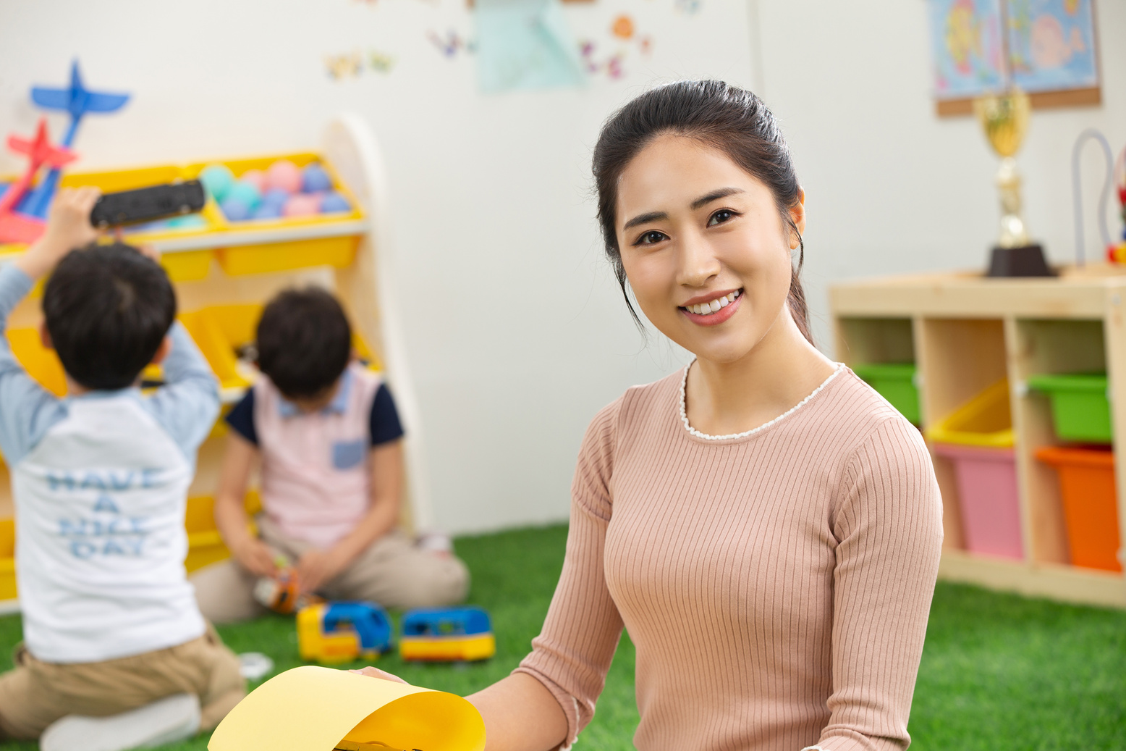

Welcome to Grade
I’m
Teacher Juliana
I'm excited to be your teacher this year

Slide 2
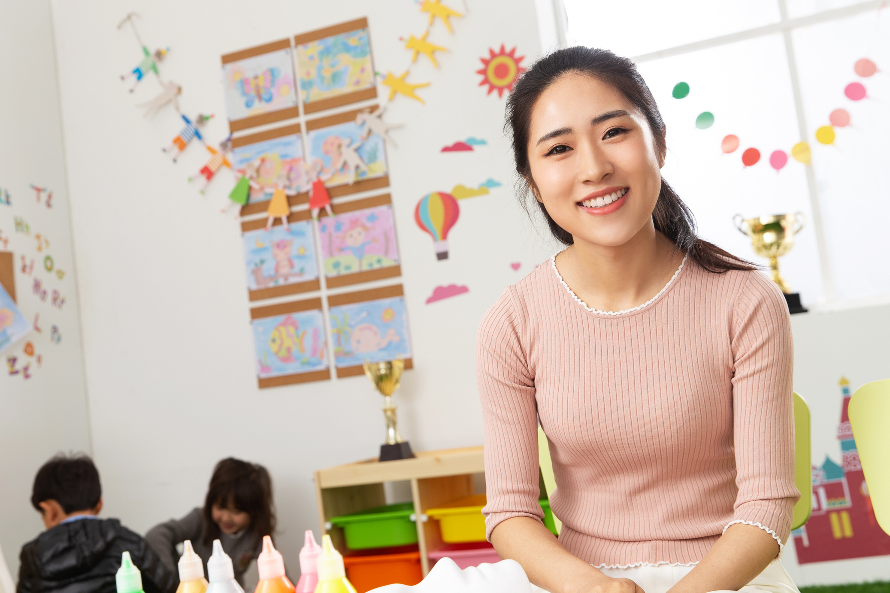

I am
Teacher Juliana
I've been teaching for 5 years.
I am from [State], [City]. I will be your teacher-adviser this year.

Slide 3




Expectations
Be respectful of yourself, others, and the classroom
Be prepared to come to class on time and ready to learn
Ask questions if you don't understand something
Complete assignments on time and to the best of your ability

Slide 4

Subject I Teach
Science
Mathematics
Social Studies

Slide 5


Class Schedule
Time
Monday
Tuesday
Wednesday
Thursday
Friday
07:00 - 08:00
08:00 - 09:00
09:00 - 10:00
10:00 - 11:00
11:00 - 12:00
12:00 - 01:00
01:00 - 02:00
02:00 - 03:00

Slide 6

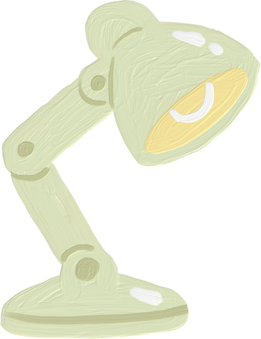
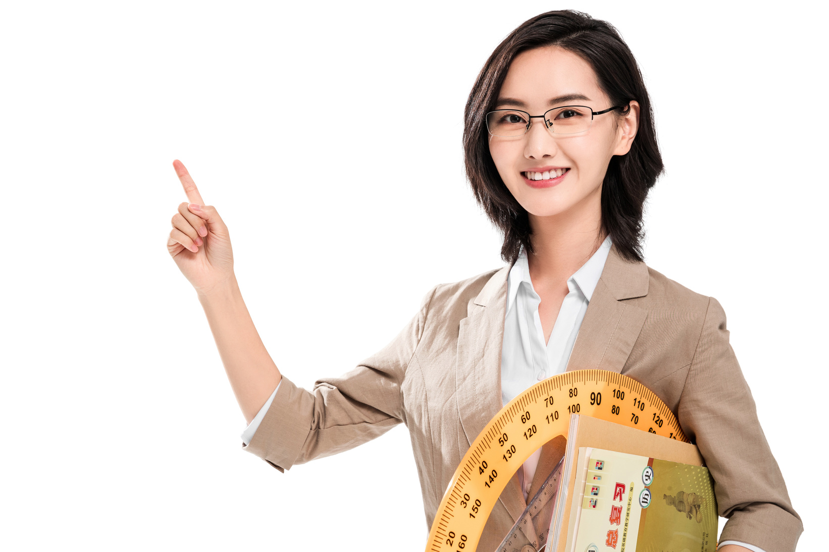

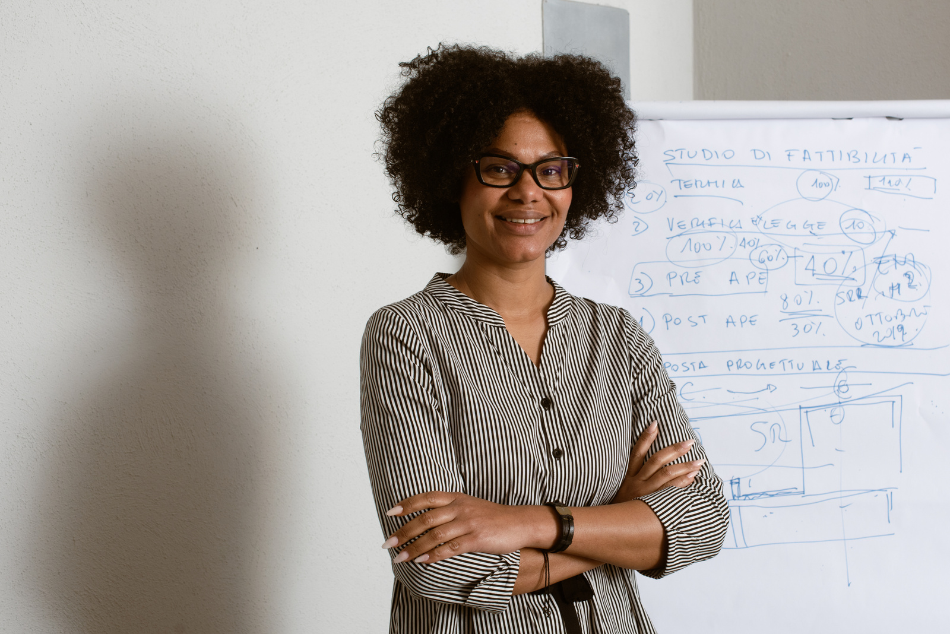
Meet your subject teachers
They are your teacher in other subjects.

Slide 7


Getting to Know You
One by one stand up
One by one, stand up
tell me about
youselft

Slide 8

If you have any query, ask me any time

